Slide 1

Drug Persistency
Presented by Emily Yao
(yaowemily@gmail.com, University of Florida, Data Science)
on 1/10/2023

Slide 2
Agenda
Background………........................3
Data Understanding…………..….…4
Quantitative Data Analysis……5-6
Patient Demographic………….7-12
Categorical Data Analysis….13-14
Recommendations (For ML)..…15
Machine Learning Results…16-19
Sources………………………………….20

Slide 3
Background
Problem Statement:
One challenge all Pharmaceutical companies face is to understand the persistency of a drug as per physician prescription. To solve this problem, ABC pharma company approached an analytics company to automate this process of identification.
ML Problem:
With an objective to gather insights on the factors that are impacting the persistency, build a classification for the given dataset.
Analysis (broken into five parts):
Data understanding
Quantitative data analysis
Patient Demographic (categorical data )
Categorial data analysis
Recommendations for a classification machine learning algorithm

Slide 4
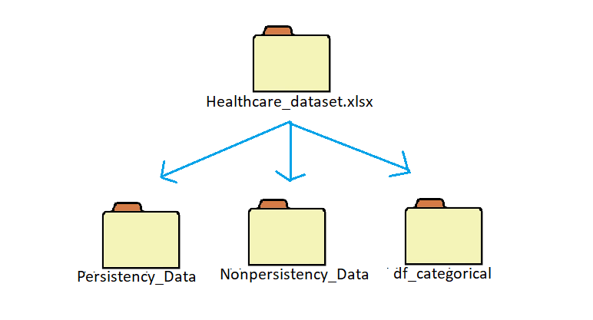
Data Understanding
General Characteristics:
69 features (columns)
No specified time frame in dataset
3,424 patients
Total data points: 236,256
Assumptions:
The patients were selected at random
The variables were collected independently from each other

Slide 5
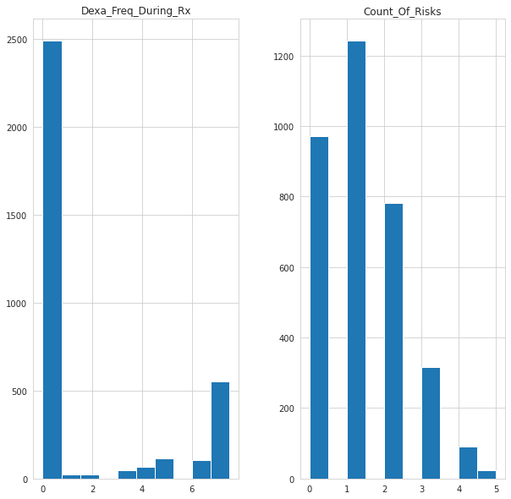
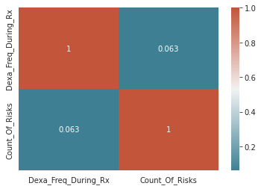
Quantitative Data Analysis
There are only two quantitative data features, and they show no noteworthy features other than being both right-tailed skewed.
Most important feature here is that most patients fall under 0-3 risk counts and less patients fall above a higher risk count.

Slide 6
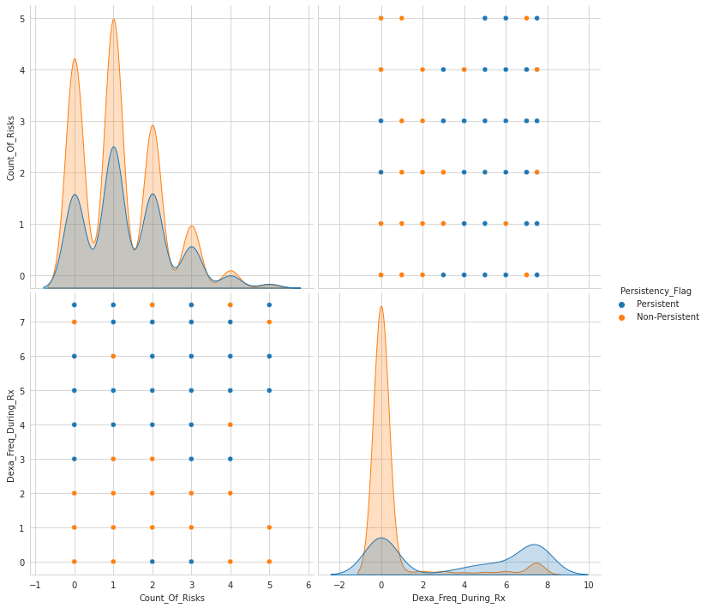
Quantitative Analysis
There is considerable overlap between “Count_Of_Risks” and “Dexa_Freq_During_Rx” with“Persistency_Flag” which suggests a visual relation.
The top graph suggests most patients (regardless of flag) has a lower risk count.
Considerably more non-persistent patients had fewer Dexa scans during the medicating period than persistent patients.

Slide 7
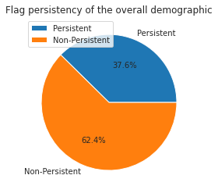
Patient Demographic- Patient Flag Persistancy

Slide 8
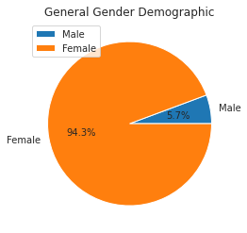
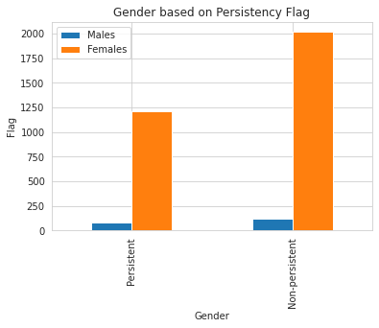
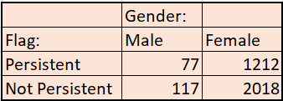
Patient Demographic- Gender
There are nearly 17x more females than males overall with both flag divisions having overall more females than male patients.

Slide 9
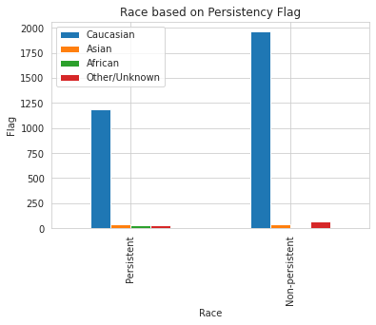
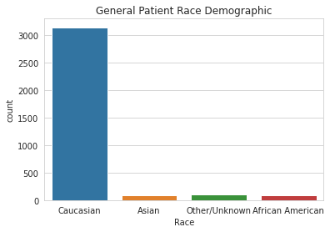
Patient Demographic- Ethnicity
The vast majority of patients overall (and for each flag division) are belonging to a Caucasian ethnicity.

Slide 10
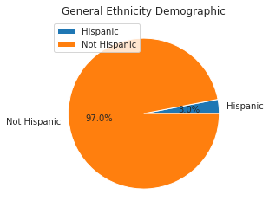
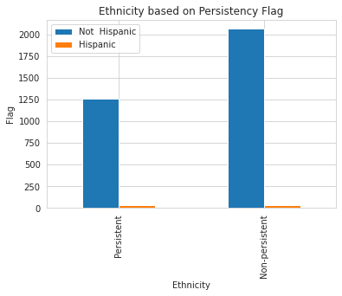
Patient Demographic- Ethnicity
Overwhelmingly proportion of patients overall (and for both flag divisions) are not Hispanic.
Specifically, non-Hispanics outnumber Hispanics by nearly 49x.

Slide 11
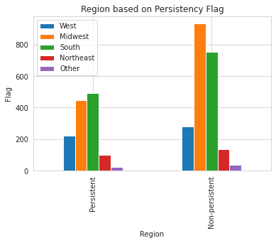
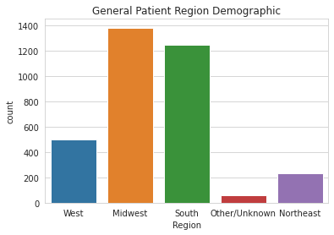
Patient Demographic- Region

Slide 12
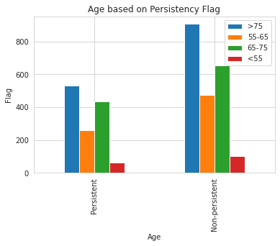
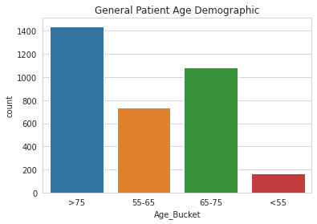
Patient Demographic- Age
Most patients are older with the majority falling older than 75 followed by a considerable number of patients between 65-75.
There is not a considerable number of patients under 65.

Slide 13
Categorical Data Analysis
A chi-square test is used to determine the association of categorical variables to flag persistency.
Alpha value that is used is 0.05 (standard)
The test calculates a p-value. If this value is <= 0.05, we reject the null and believe the variables are associated with each other. If the p-value is > 0.05, we fail to reject the null and believe the variables have no association with one another.
H0 (null): The two categorical variables are
independent
H1 (alternative): The two categorical variables are dependent

Slide 14
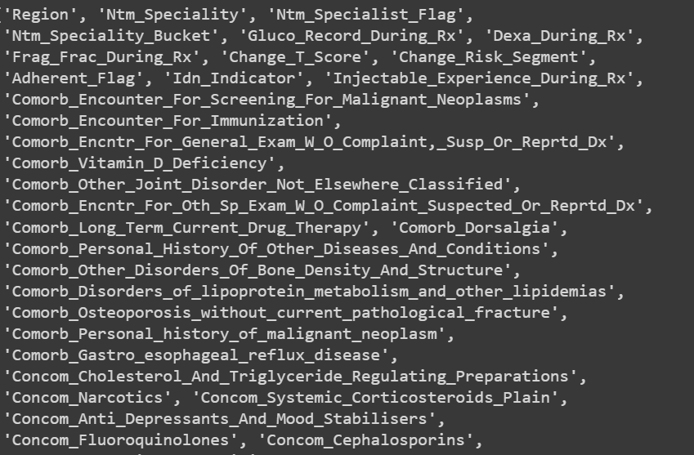
Categorical Data Analysis
Around 44 of the 69 features or 64% of the variables are said to be dependent with flag persistency (2 quantitative and 67 categorical variables).
It will be these 44 features that will be going into our machine learning model.
The picture to the right, listing some of the features, is not comprehensive

Slide 15

Recommendations (Machine Learning Models)
We will be using a binary classification algorithms to predict flag persistency.
Binary classification is used for data where there are only two outcomes which takes on either a “0” or a “1.” in our case, the cases match non-persistency and persistency, respectively.
Visually represented by the discrete Bernoulli distribution.
Models to consider:
Logistic Regression
Support Vector Machines
Simply Bayes
Decision Trees

Slide 16

Machine Learning Results
A multiple linear regression model was selected due to a lack of comparable test datasets needed for other choices i.e., decision trees. Before we dive into the results, let us state the assumptions:
Linearity
Independence
Homoscedasticity
Normality

Slide 17

Machine Learning Results
The multiple linear regression model has proved to not be a good fit. Here is why:
The coefficient of determination is about 0.4 (weak). For comparison, a 1.0 represents a perfect fit. This might be an indication of underfitting and that we need to use a more complicated model.
Some of the individual ${R^{2}}^{′}s$ for the independent variables turned out negative.
The assumptions might not be applicable with our data.
Solution: Fit the data with a multivariate polynomial regression model with a degree that is > 1.

Slide 18
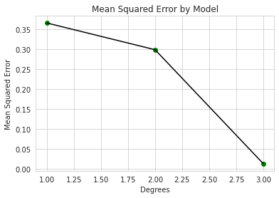
Machine Learning Results
The new model created using a multivariate polynomial model at degree three shows the most promising fit for the data, producing a mean squared error of about 0.012 and a root mean squared error of roughly 0.11 which is considerably better than the linear model at about 0.14 and 0.39, respectively.
A degree three polynomial was chosen to limit overfitting from higher-order terms.
As a standard, root mean squared error is usually a better indicator of model fit than the alternative.

Slide 19

Limitations & Expansion
If I were to repeat this project, this is what I would have done differently:
Conducted my quantitative data analysis after transforming my dataset (consisting of mostly categorical data) into numerical values.
Tested out assumptions before jumping into a model.
It would be the most optimal to have multiple datasets like ours to test for drug persistency. If we had this, we could:
Implement more sophisticated classification algorithms.
Implement boosting models i.e., discrete AdaBoost would be a strong choice as it deals with binary classification problems.
Implemented a logarithmic model and compared the results with the ones obtained from the multivariate polynomial regression model.

Slide 20

Sources
https://enjoymachinelearning.com/blog/multivariate-polynomial-regression-python/
https://data36.com/polynomial-regression-python-scikit-learn/
https://www.linkedin.com/pulse/my-first-exploratory-data-analysis-project-dr-ragini-selukar/
https://stephenallwright.com/rmse-vs-mse/#:~:text=RMSE%20is%20one%20of%20the,is%20often%20preferred%20over%20MSE.
https://www.linkedin.com/posts/emilyyao1_introductory-data-cleaning-activity-7013640766505820160-0MWM?utm_source=share&utm_medium=member_desktop
https://machinelearningmastery.com/adaboost-ensemble-in-python/
https://intellipaat.com/blog/what-is-linear-regression/#Multiple-Linear-Regression-Model
https://scikit-learn.org/stable/modules/generated/sklearn.linear_model.LinearRegression.html
https://realpython.com/linear-regression-in-python/#polynomial-regression

Slide 21
The End.
Thank You

